Slide 1
LoRa
Fedir, Richard, Jian

Slide 2
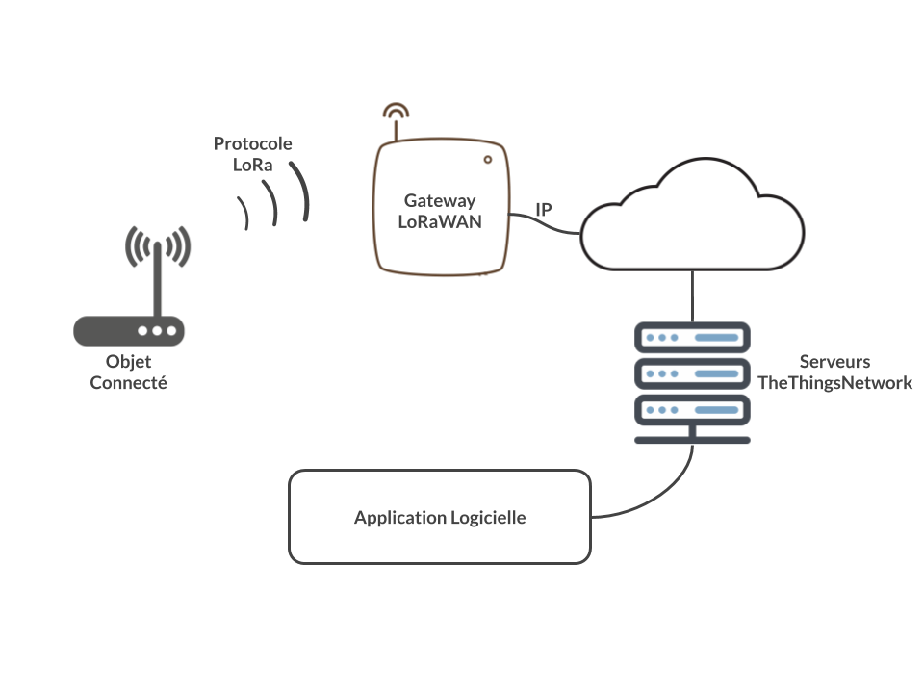
What is LoRa
LoRa, short for Long Range, is a wireless communication technology designed for long-range, low-power communication between IoT (Internet of Things) devices. It operates on unlicensed radio frequencies and is characterized by its long-range capabilities, low power consumption, and ability to penetrate obstacles.

Slide 3
Characteristics of LoRa
Long Range: LoRa can provide communication over distances of several kilometers in urban environments and even tens of kilometers in rural areas, depending on the line-of-sight conditions and terrain.
Low Power Consumption: LoRa devices are designed to operate on battery power for extended periods, making them suitable for IoT applications where power efficiency is crucial.
Low Data Rates: LoRa supports relatively low data rates compared to other wireless technologies like Wi-Fi or cellular. This trade-off enables longer-range communication while conserving battery life.

Slide 4
Comparison between LoRa and ESP8266
Range:
LoRa: LoRa technology provides long-range communication, typically several kilometers in urban environments and even tens of kilometers in rural areas, with line-of-sight conditions.
ESP8266: ESP8266 provides local area network (LAN) connectivity through Wi-Fi, typically limited to indoor or local outdoor environments within the range of a Wi-Fi router.
Data Rates:
LoRa: LoRa supports relatively low data rates compared to other wireless technologies like Wi-Fi or cellular. This trade-off enables longer-range communication while conserving battery life.
ESP8266: ESP8266 supports higher data rates compared to LoRa, making it suitable for applications requiring higher throughput or real-time communication over Wi-Fi networks.
Use Cases:
LoRa: LoRa is commonly used in IoT applications where long-range communication is required, such as smart cities, agriculture, environmental monitoring, and asset tracking.
ESP8266: ESP8266 is widely used in IoT projects for connecting devices to Wi-Fi networks and the internet. It is used in applications such as home automation, smart devices, IoT sensors, and Wi-Fi-enabled gadgets.

Slide 5
Usage Scenario
Smart Cities: LoRa is used in smart city projects for applications such as smart street lighting, waste management, parking management, environmental monitoring, and public safety systems. Its long-range capabilities make it ideal for connecting sensors and devices spread across a wide area.
Agriculture: In agriculture, LoRa is used for remote monitoring of soil moisture levels, temperature, humidity, and other environmental parameters. It enables farmers to optimize irrigation, manage crops more efficiently, and reduce water consumption.
Healthcare: In healthcare, LoRa technology is used for remote patient monitoring, asset tracking in hospitals, and tracking medical equipment. It enables healthcare providers to collect patient data and monitor the condition of medical devices in real time.

